Slide 1

Salary Prediction Using Linear Regression
MACHINE LEARNING PROJECT
NAME : NIKHITA R PATTAR
COURSE : BCA 5TH SEM
INSTITUTE : DIGITIAL DREAMS OF INSTUTION

Slide 2
Problem Statement
• Predict the salary of an employee based on years of experience
• Use Linear Regression to model the relationship
• Provide accurate salary estimation for HR decision-making

Slide 3
Dataset
• Columns:
- YearsExperience
- Salary
• Simple dataset used to build regression model
• Data split into training and testing sets

Slide 4
Techniques Used
• Data Preprocessing
• Train–Test Split
• Linear Regression Model
• Evaluation using Mean Squared Error (MSE)

Slide 5
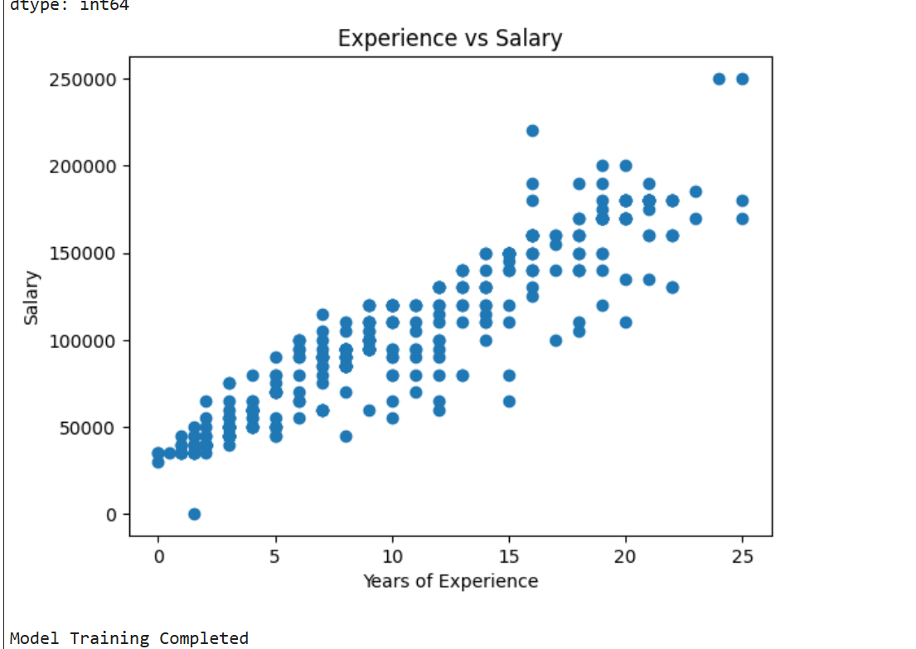

Slide 6
Conclusion
• Linear Regression effectively predicts salary
• Model shows clear positive correlation between experience and salary
• Useful for HR analytics and salary forecasting

